Slide 1


Taxi Ride Demand Prediction using Machine Learning
By Group – 17:
Dheeraj Podishetty
Sai Krishna Kakollu
Sai Karthik Gamineedi
Amulya Bodempudi
Rahul Varma Muppalla

Slide 2
Participants and Roles
Sl.no | Name | Mail | Roles & Reponsibility
1) | Dheeraj Podishetty | dheerajpodishetty@my.unt.edu | Leading & Developing the modules
2) | Sai Krishna Kakollu | Saikrishnakakollu@my.unt.edu | Testing & Documentation
3) | Sai Karthik Gamineedi | saikarthikgamineedi@my.unt.edu | Documentation
4) | Amulya Bodempudi | amulyabodempudi@my.unt.edu | Development
5) | Rahul Varma Muppalla | RahulVarmaMuppalla@my.Unt.edu | Data Analysis & Testing

Slide 3
Introduction:
Abstract: The Taxi Ride Demand Prediction project aims to develop reliable machine learning models for accurately predicting the demand for taxi rides in each area. The project involves collecting and pre-processing vast amounts of data on taxi rides, weather patterns, and other relevant factors, and using this data to train and fine-tune machine learning algorithms. The project's objective is to increase taxi demand prediction accuracy by using various prediction techniques. The project compares the predicted accuracy of several machine learning methods, including regression, extreme gradient boosting models, and time series analysis, and evaluates their performance. The results show that machine learning models can accurately forecast taxi ride demand, with some models outperforming others based on the specific context and data provided. The project has real-world applications for taxi businesses looking to improve their operations and customer experience through data-driven decision-making.
Predict taxi demand
Improve efficiency
Optimize resources
Reduce wait times
Increase revenue

Slide 4
Design & Workflow
Taxi Trip Dataset/ Initial Dataset Overview
Training the Machine with existing data set
Transforming the Trained Data
Data Visualisation
Predicting Future Demand

Slide 5
Data Collection & Pre-processing
Cleaning
Pre-Processing
Collection

Slide 6
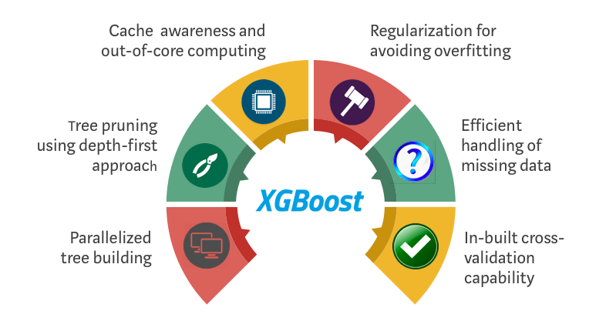
Data Modelling and Evaluation Algorithms
Linear Regression
Relatively efficient
Relevance of features
Good on large datasets
Integration effectiveness
Efficient at training

Slide 7

Optuna
Optuna
Hyperparameter optimization
Automated tuning
Efficient search
Flexible framework
Scalable solution

Slide 8
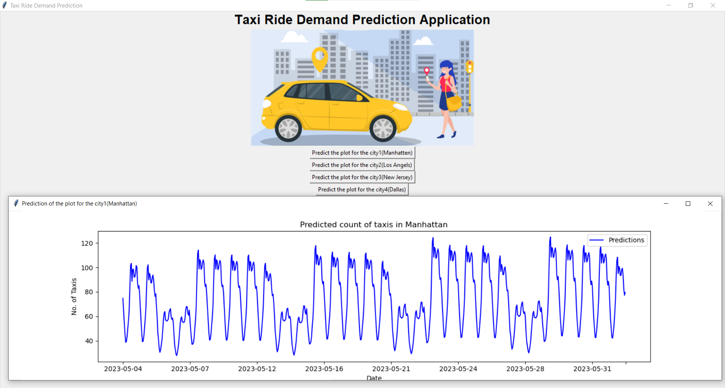
Demonstration & Results

Slide 9
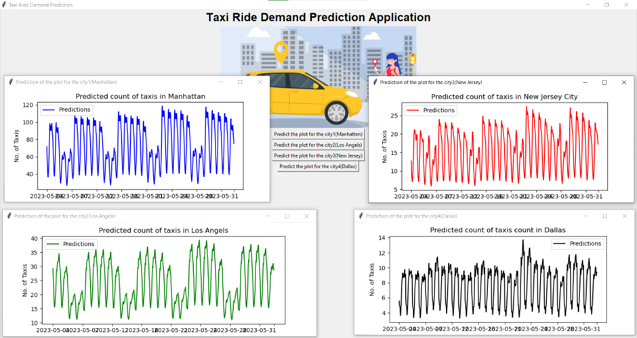

Slide 10
Conclusion
Data Collection
Data Cleaning
Model Selection
Model Training
Hyperparameter Tuning
Model Evaluation
Final Results

Slide 11

Future Advancement Work

Slide 12
References
Uber Engineering's article on demand prediction using neural networks (https://eng.uber.com/neural-networks/)
This article describes how Uber uses neural networks to predict demand for its ride-hailing services. While our project focuses on predicting demand for traditional taxi services, this resource provides a good comparison to our approach and insights into neural network models.
Kaggle's NYC Taxi and Limousine Commission Trip Record Data (https://www.kaggle.com/c/nyc-taxi-trip-duration)
This dataset contains historical data on taxi trips in New York City, which is like the data we will be using in our project. We can use this dataset to compare our model's performance to other models and approaches on Kaggle.
Traffic Prediction Dataset. (2021, February 19). Kaggle. (https://www.kaggle.com/datasets/fedesoriano/traffic-prediction-dataset)
Sohaibanwaar. (2021). Taxi Demand Prediction. Kaggle. https://www.kaggle.com/code/sohaibanwaar1203/taxi-demand-prediction#notebook-container
Collinsakal. (2023). Traffic Prediction EDA + Stacking. Kaggle. https://www.kaggle.com/code/collinsakal/traffic-prediction-eda-stacking#Development-Summary

